Slide 1
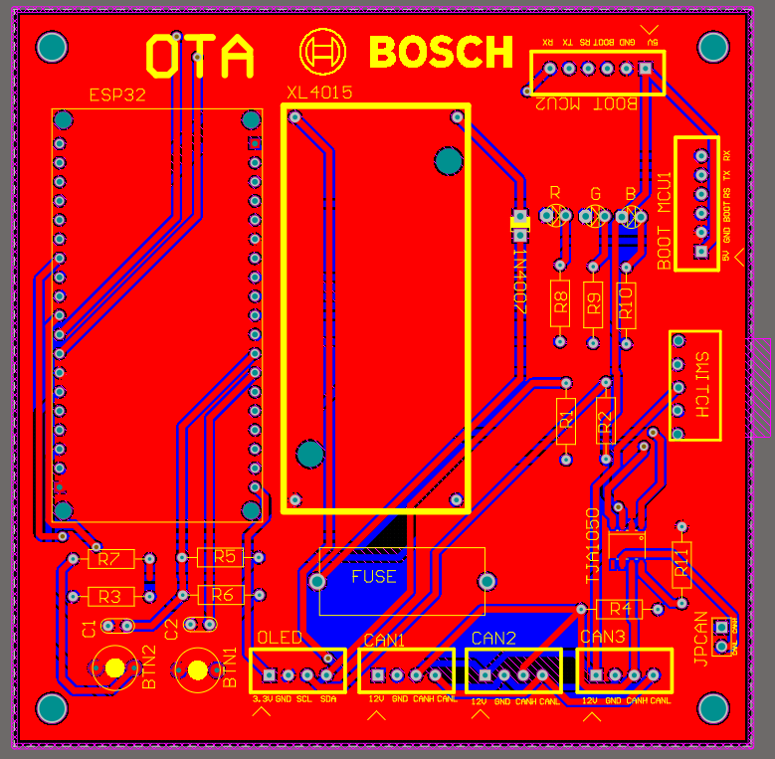
OTA PCB

Slide 2
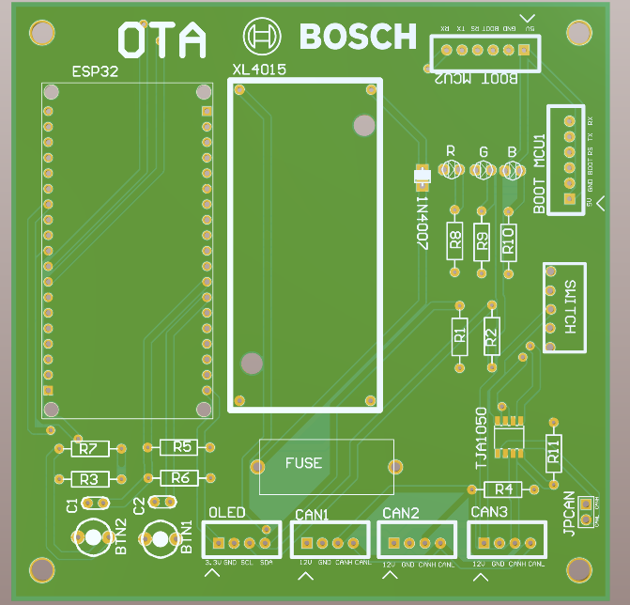
OTA PCB NO 3D VIEW BODIES

Slide 3
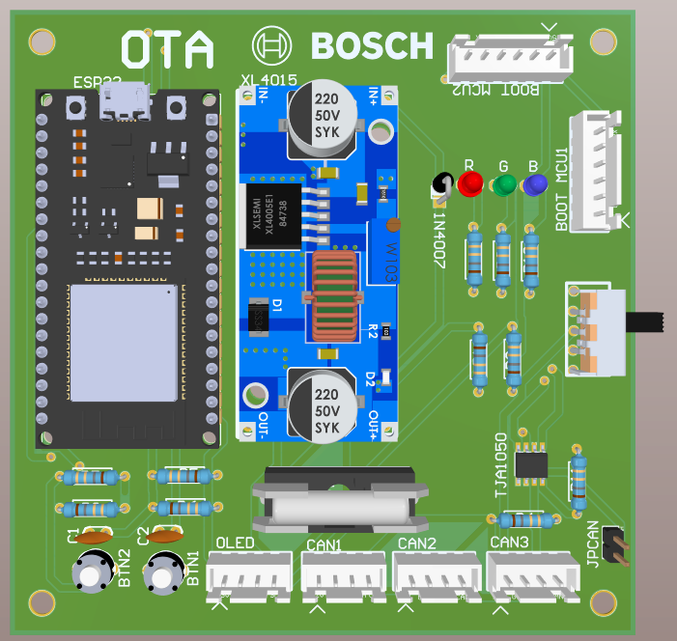
OTA PCB 3D

Slide 4
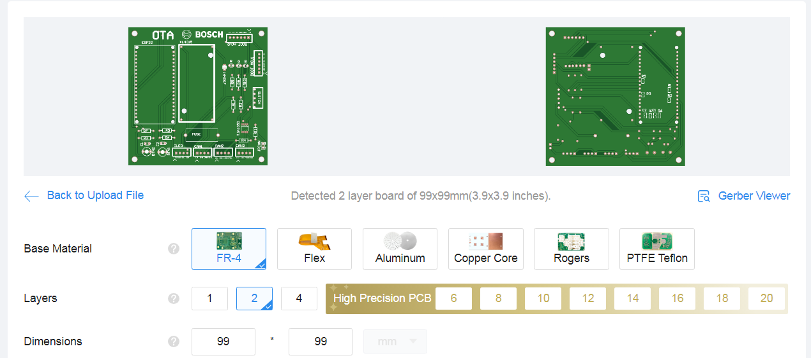

Slide 5
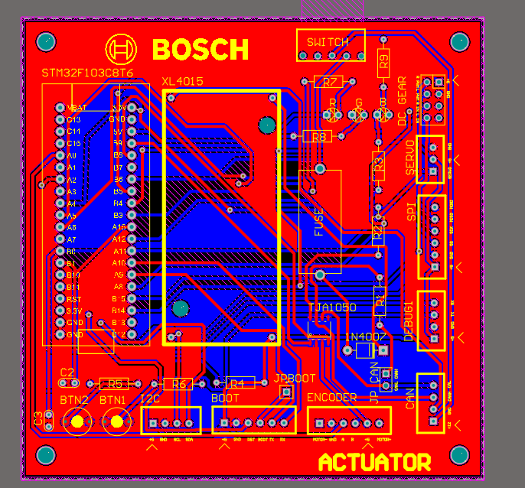
ACTUATOR PCB

Slide 6
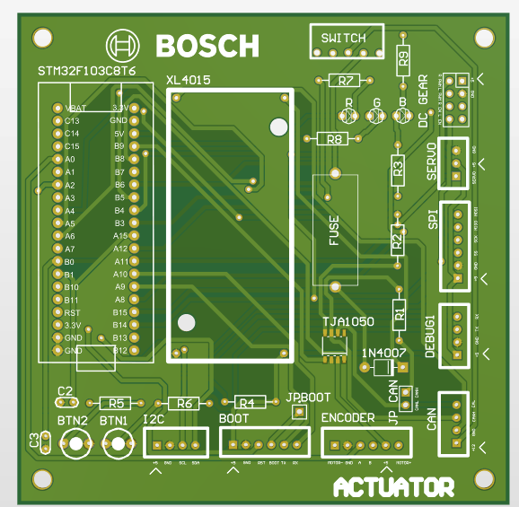
ACTUATOR PCB NO 3D VIEW BODIES

Slide 7
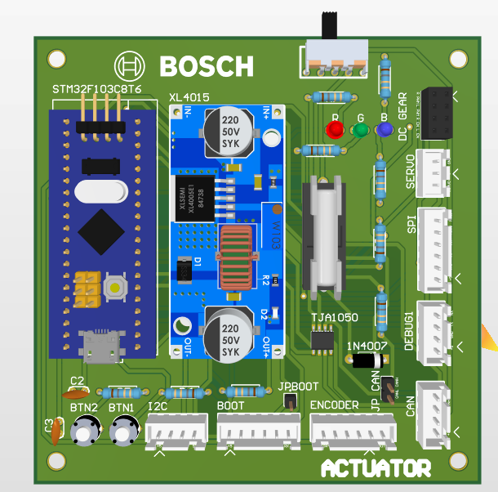
ACTUATOR PCB 3D

Slide 8
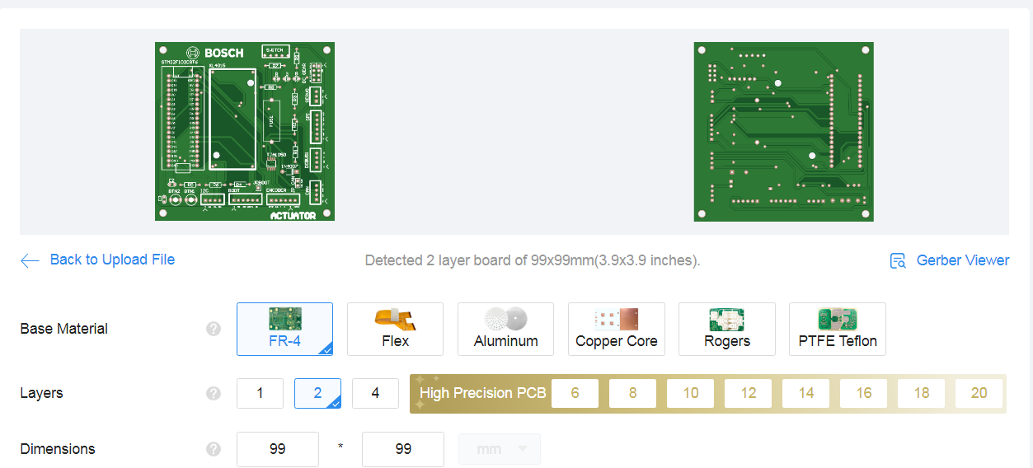

Slide 9
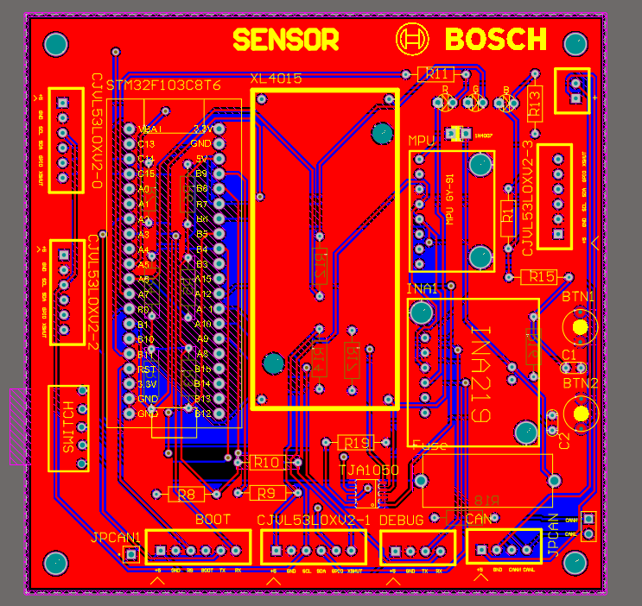
SENSOR PCB

Slide 10
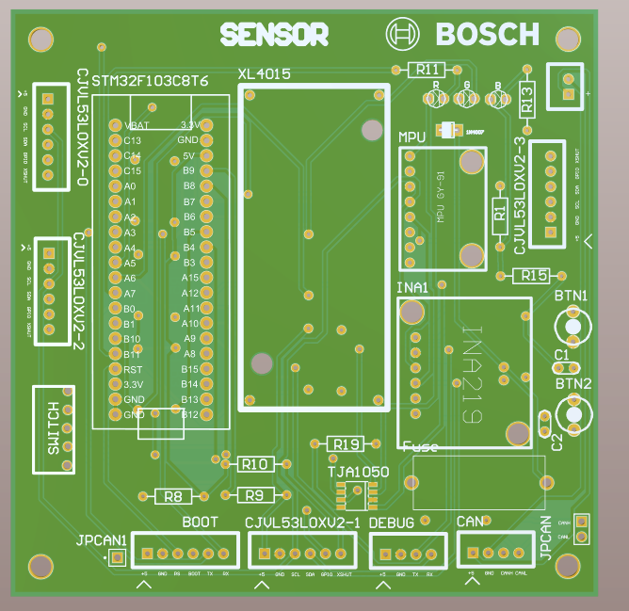
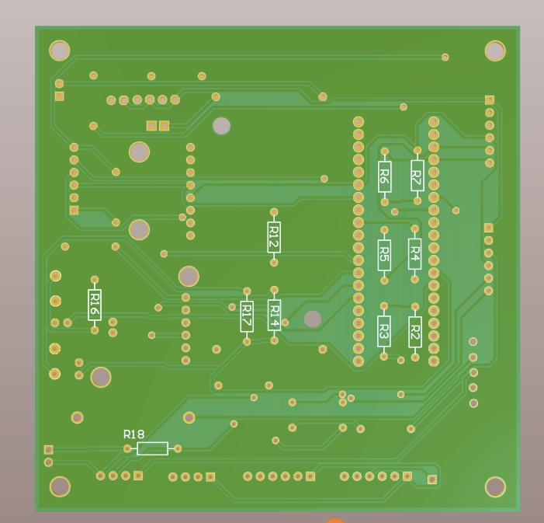
SENSOR PCB VIEW NO 3D BODIES
FRONT
BACK

Slide 11
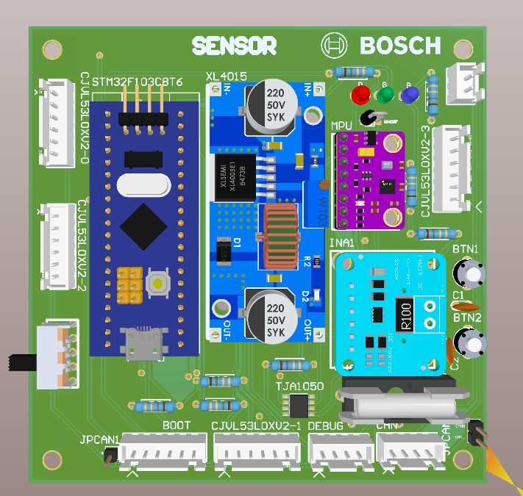
SENSOR PCB VIEW FRONT

Slide 12
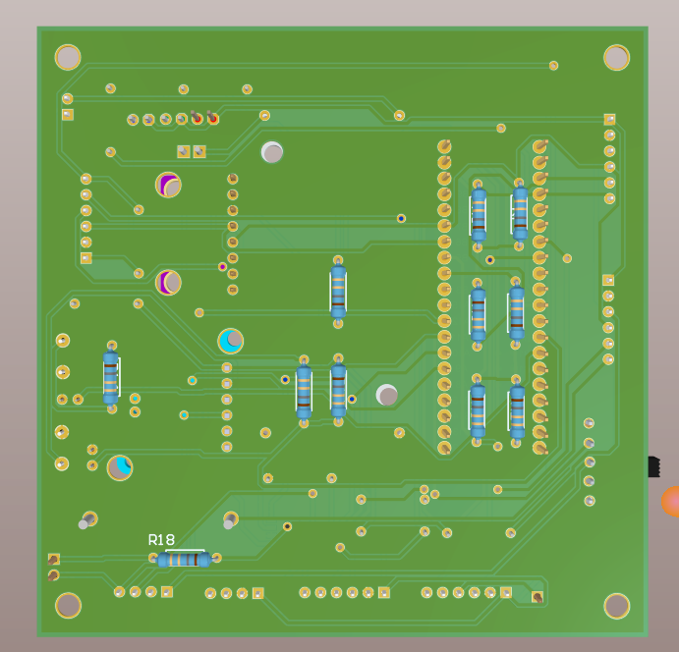
SENSOR PCB VIEW BACK

Slide 13
